Slide 1

AI Week 4: Deep Neural Networks
Deep Learning (Chapter 6)
Chia-Hui Chang
chiahui@g.ncu.edu.tw
Video link

Slide 2


Join at slido.com #3347718
ⓘ Start presenting to display the joining instructions on this slide.

Slide 3
Recap of Machine Learning
Recipe for ML
Model family f(y|x)
Cost function: + Regularization
Gradient Based Learning
Notes:
KL divergence: the amount of information lost when Q is used to approximate P
Cross Entropy: expected message-length when a wrong distribution Q is assumed while the data actually follows a distribution P

Slide 4
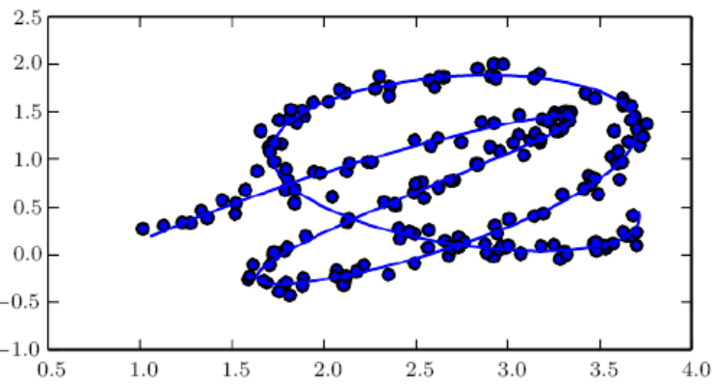
Motivation for DNN
manual Feature engineering
Domain knowledge
Hard to design for images
Function family: Kernel function in SVM:
RBF kernel, polynomial kernel
Feature representation
Let machine learns the features themselves
Hidden layer in Neural Network
Deep Neural Networks (DNN) for Manifold learning

Slide 5
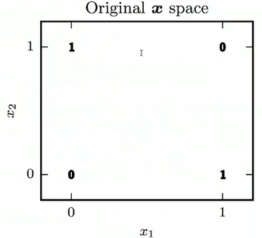
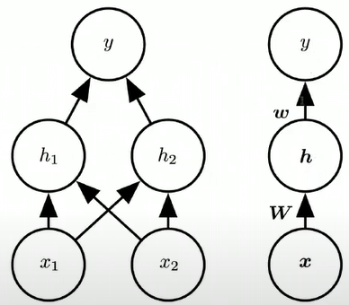
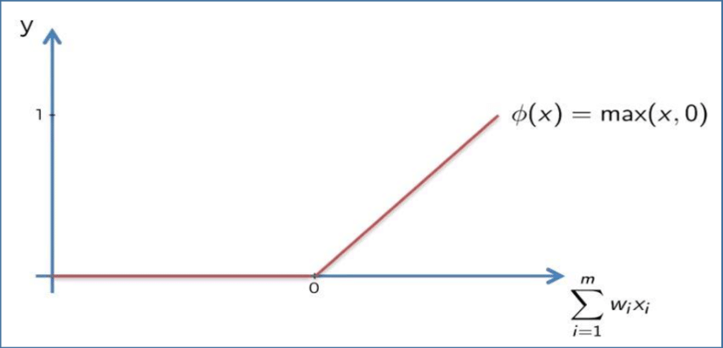
Example: Learning XOR function
XOR is not linearly
Use Neural Network Diagrams to
Compute features with hidden units
Rectified Linear Activation

Slide 6
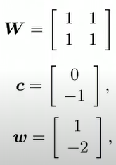
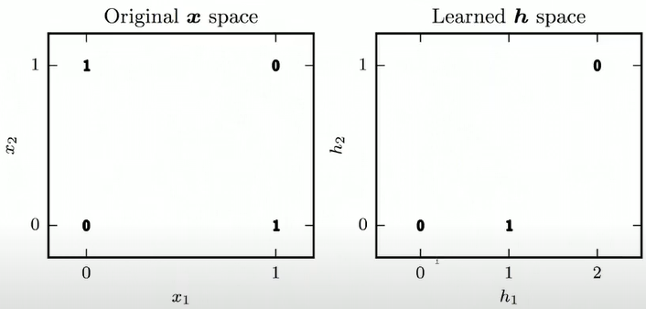

Solving XOR
Rectified Activation Function
$$\text{Matrix} \text{Calculator}$$

Slide 7
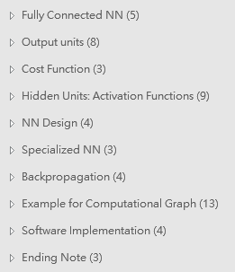
Plan for This Lecture
Feedforward Neural Networks (ANN)
Fully connected NN: Neurons, composite function
output units + cost function
hidden layer + activation functions
Training
Back-propagation algorithm
Computational Graph
Design issues
Choice of Network Depth/width, Validation set error
Specialized Network architecture: CNN, RNN, LSTM, GRU

Slide 8
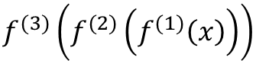
Neural Networks
Feedforward Neural Networks, Multilayer perceptrons
Neuron: vector-to-scalar function f: R^{n}→R
MultiLayer Neural Networks: inspired by neuroscience
Each hidden layer is typically vector-valued
Feedforward: no feedback connections
Networks: composing different functions
the width of the model ≅ The Max dimension of the these hidden layers
the DEPTH of the model ≅ The number of the these hidden layers
$$f^{(3)}\left(f^{(2)}\left(f^{(1)}\left(x\right)\right)\right)$$
3rd layer
1st layer
Notes:
No feedback connections
Information flows through functions from x to output y
When feedforward neural networks are extended to include feedback connections they are called Recurrent Neural Networks
Convolutional networks are a special kind of feedforward networks

Slide 9
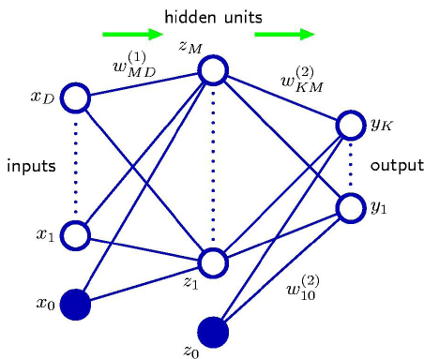
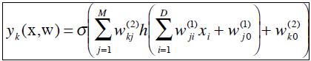
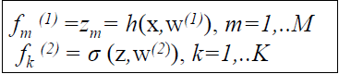
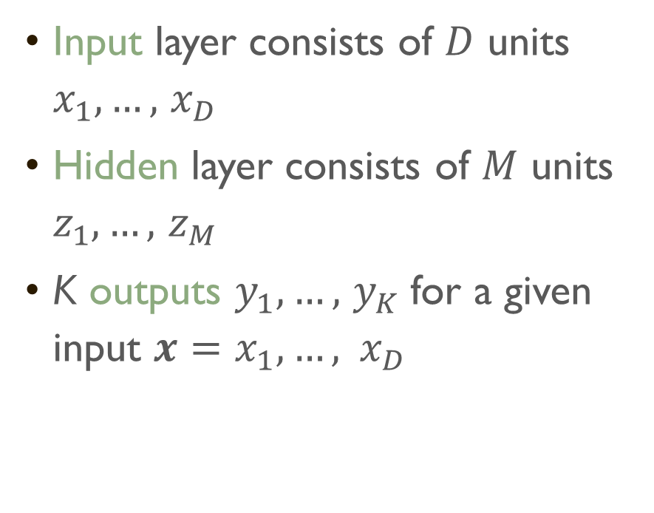

One-hidden layer Fully connected Neural Network
Input layer consists of $D$ units $x_{1},…,$ $x_{D}$
Hidden layer consists of $M$ units $z_{1},…,$ $z_{M}$
K outputs $y_{1},…,$ $y_{K}$for a given input $x=x_{1},…, x_{D}$
w_{j0}
$$z_{j}$$
h: activation function for hidden layer
σ: activation function for output layer
Notes:
Behavior of other layers is not directly specified by the data
Learning algorithm must decide how to use those layers to produce value that is close to y
Training data does not say what individual layers should do
Since the desired output for these layers is not shown, they are called hidden layers

Slide 10

Relations between Layer $l−1$ and layer $l$
…
…
……
……
……
……
Layer
Layer
nodes
nodes

Slide 11
Activation function
……
……
……
……
Layer
Layer
nodes
nodes

Slide 12
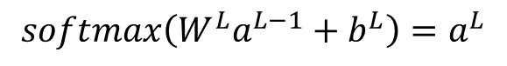
Composite of functions
Input
Layer 1
Layer 2
Layer L
Output
……
y₁
vector
y
vector
x
……
y₂
……
……
……
……
……
……
y_{K}
x_{D}
$$softmax\left(W^{L}a^{L−1}+b^{L}\right)=a^{L}$$
Notes:
Draw it?

Slide 13

下列關於Fully Connected Neural Network 的敘述何者錯誤?
ⓘ Start presenting to display the poll results on this slide.

Slide 14
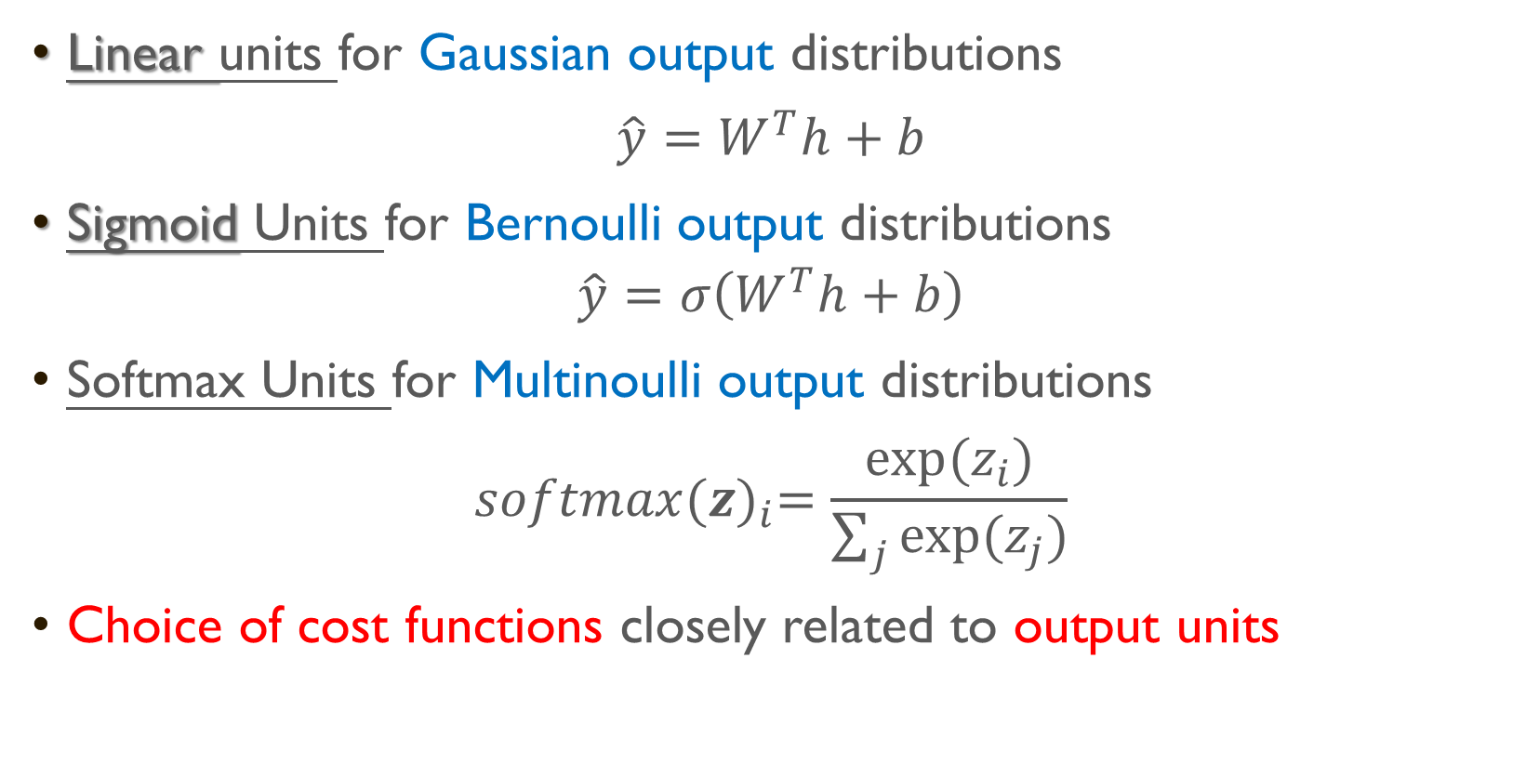
Different Output Units
Linear units for Gaussian output distributions
$\hat{y}=W^{T}h+b$
Sigmoid Units for Bernoulli output distributions
$$\hat{y}=σ\left(W^{T}h+b\right)$$
Softmax Units for Multinoulli output distributions
$$softmax{(z)}_{i}=\frac{exp⁡(z_{i})}{\sum_{j}{exp⁡(z_{j})}}$$
Choice of cost functions closely related to output units
No non-linearity
Or Softplus
Notes:
Other output types
Not direct prediction of y but provide parameters of distribution over y

Slide 15
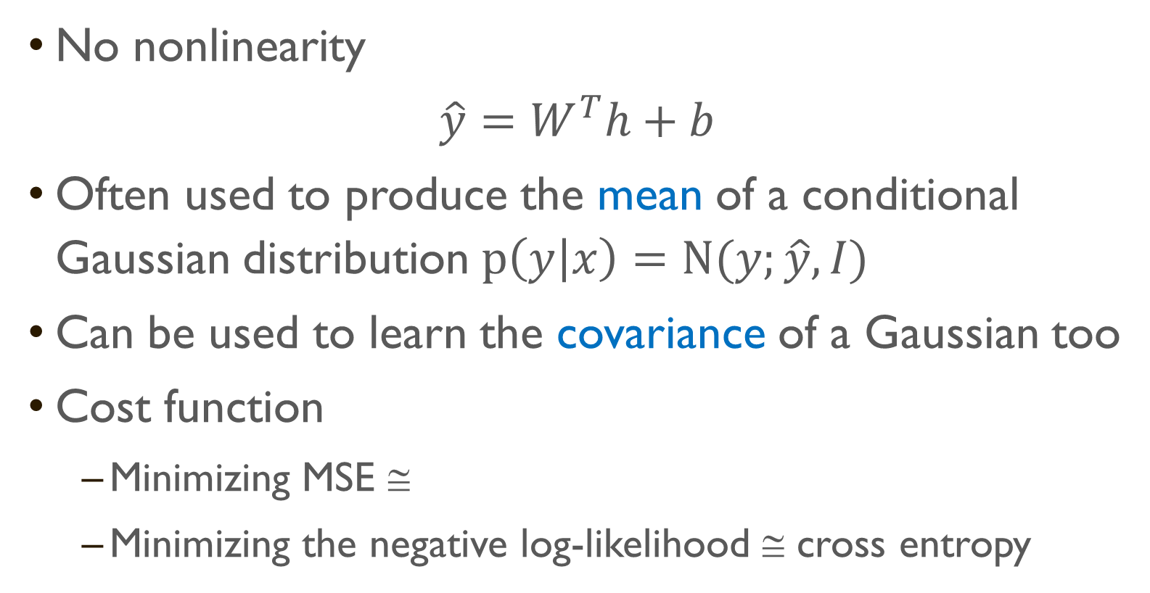
Linear units for Gaussian Distributions
No nonlinearity
$\hat{y}=W^{T}h+b$
Often used to produce the mean of a conditional Gaussian distribution $p\left(y | x\right)=N(y;\hat{y}, I)$
Can be used to learn the covariance of a Gaussian too
Cost function
Minimizing MSE ≅
Minimizing the negative log-likelihood ≅ cross entropy

Slide 16
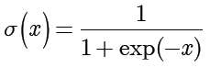
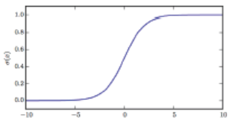
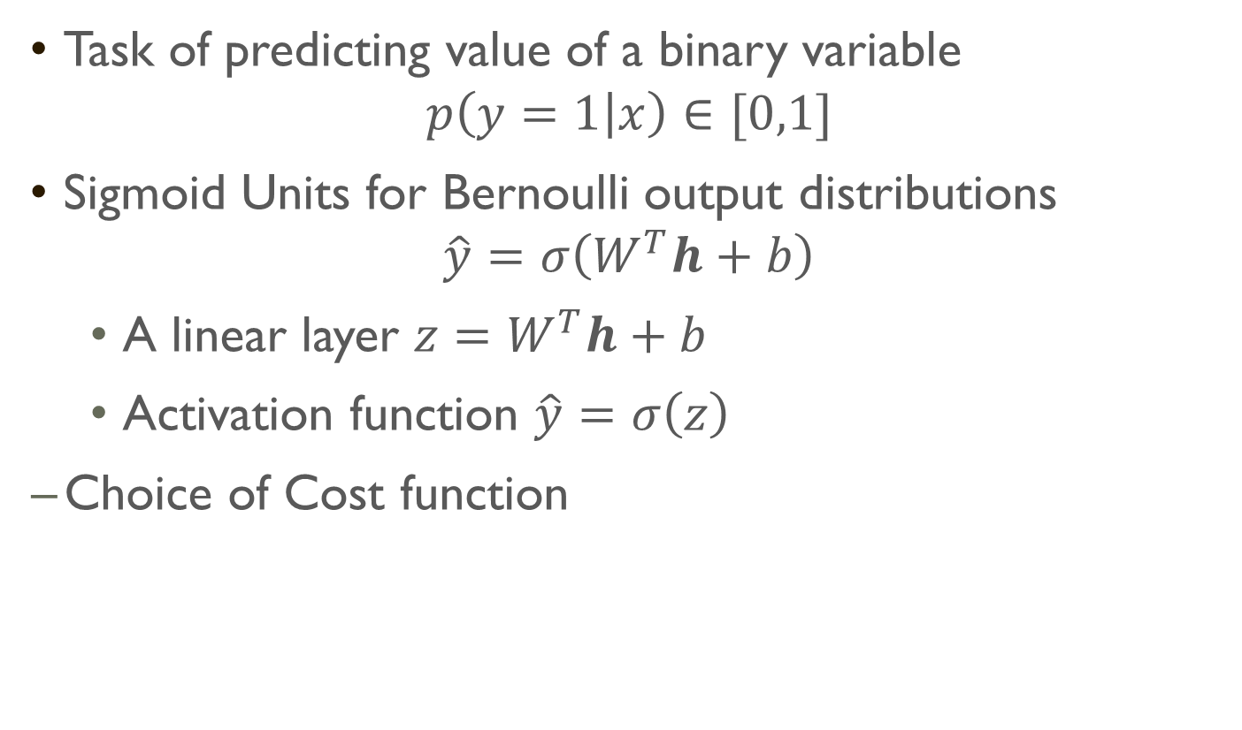
Sigmoid Units for Bernoulli Distributions
Task of predicting value of a binary variable
$$p\left(y=1 | x\right)∈[0,1]$$
Sigmoid Units for Bernoulli output distributions
$$\hat{y}=σ\left(W^{T}h+b\right)$$
A linear layer $z=W^{T}h+b$
Activation function $\hat{y}=σ\left(z\right)$
Choice of Cost function
For sigmoid output which cost function is better?
Negative Log likelihood
Mean Squared Error
Notes:
Probability distributions based on exponentiation and normalization are common throughout the statistical modeling literature.
Ensures there is always a strong gradient whenever the model has the wrong answer.

Slide 17
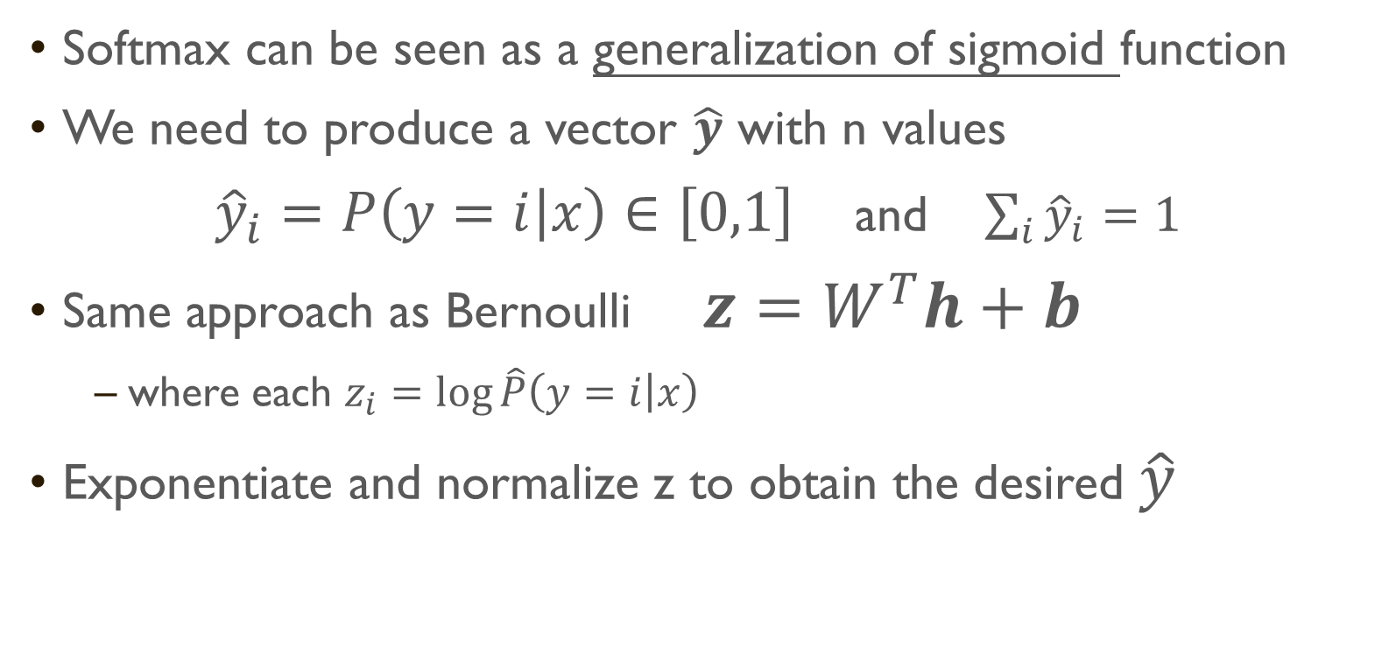
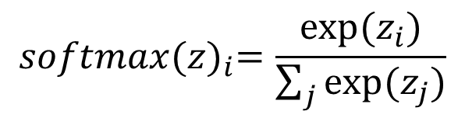
Softmax Units for Multinoulli Output
Softmax can be seen as a generalization of sigmoid function
We need to produce a vector $\hat{y}$ with n values
${\hat{y}}_{i}=P\left(y=i | x\right)∈\left[0,1\right]$ and $\sum_{i}{{\hat{y}}_{i}}=1$
Same approach as Bernoulli $z=W^{T}h+b$
where each $z_{i}=\log{\hat{P}\left(y=i | x\right)}$
Exponentiate and normalize z to obtain the desired $\hat{y}$
$$softmax{(z)}_{i}=\frac{exp⁡(z_{i})}{\sum_{j}{exp⁡(z_{j})}}$$
Notes:
Task of learning for a discrete variable with n values

Slide 18
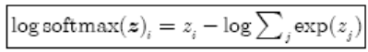
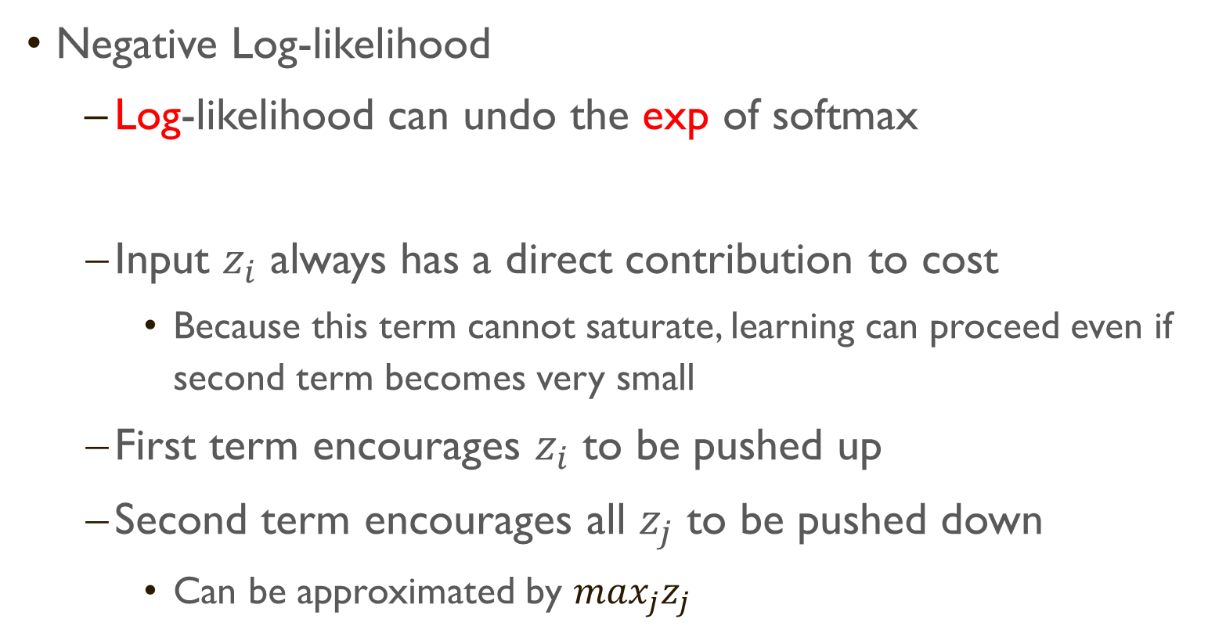
Softmax and Log-Likelihood Cost function
Negative Log-likelihood
Log-likelihood can undo the exp of softmax
Input $z_{i}$ always has a direct contribution to cost
Because this term cannot saturate, learning can proceed even if second term becomes very small
First term encourages $z_{i}$ to be pushed up
Second term encourages all $z_{j}$ to be pushed down
Can be approximated by $\max_{j}z_{j}$
Notes:
Intuition gained
Cost function penalizes most active incorrect prediction
If the correct answer already has the largest input to softmax, then the 1st and 2nd term will roughly cancel
Unregularized Maximum Likelihood will drive the softmax to predict the fraction of counts for each outcome
i.e. $softmax{\left(z(x;θ)\right)}_{i}≈\frac{\sum_{j=1}^{m}{1_{y^{(i)}=i,x^{(i)}=x}}}{\sum_{j=1}^{m}{1_{x^{(i)}=x}}}$

Slide 19
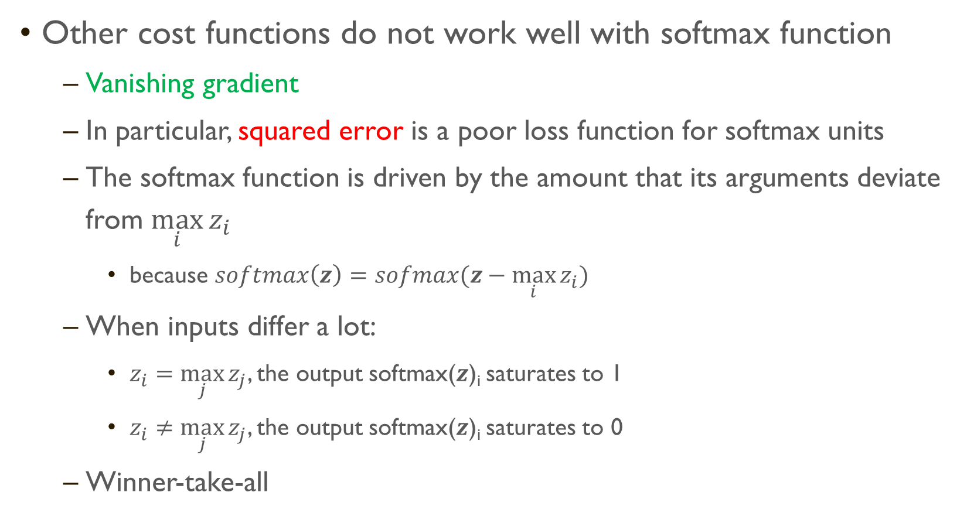
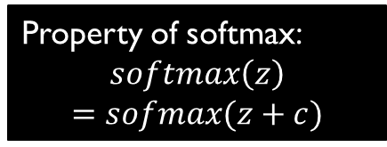
Softmax and Other Cost Functions
Other cost functions do not work well with softmax function
Vanishing gradient
In particular, squared error is a poor loss function for softmax units
The softmax function is driven by the amount that its arguments deviate from $\max_{i}{z_{i}}$
because $softmax\left(z\right)=sofmax(z−\max_{i}{z_{i}})$
When inputs differ a lot:
$z_{i}=\max_{j}{z_{j}}$, the output softmax($z$)_{i} saturates to 1
$z_{i}≠\max_{j}{z_{j}}$, the output softmax($z$)_{i} saturates to 0
Winner-take-all
Property of softmax:
$$softmax\left(z\right)$$
$$=sofmax(z+c)$$
Notes:
Objective function that do not use a log to undo the exp of softmax fail to learn when the argument to the exp becomes very negative, causing gradient to vanish
The softmax function is driven by the amount that its arguments deviate from $\max_{i}{z_{i}}$
because $softmax\left(z\right)=sofmax(z−\max_{i}{z_{i}})$
When inputs differ a lot:
$z_{i}=\max_{j}{z_{j}}$, the output softmax(z)_{i} saturates to 1
$z_{i}≠\max_{j}{z_{j}}$, the output softmax(z)_{i} saturates to 0
Winner-take-all

Slide 20
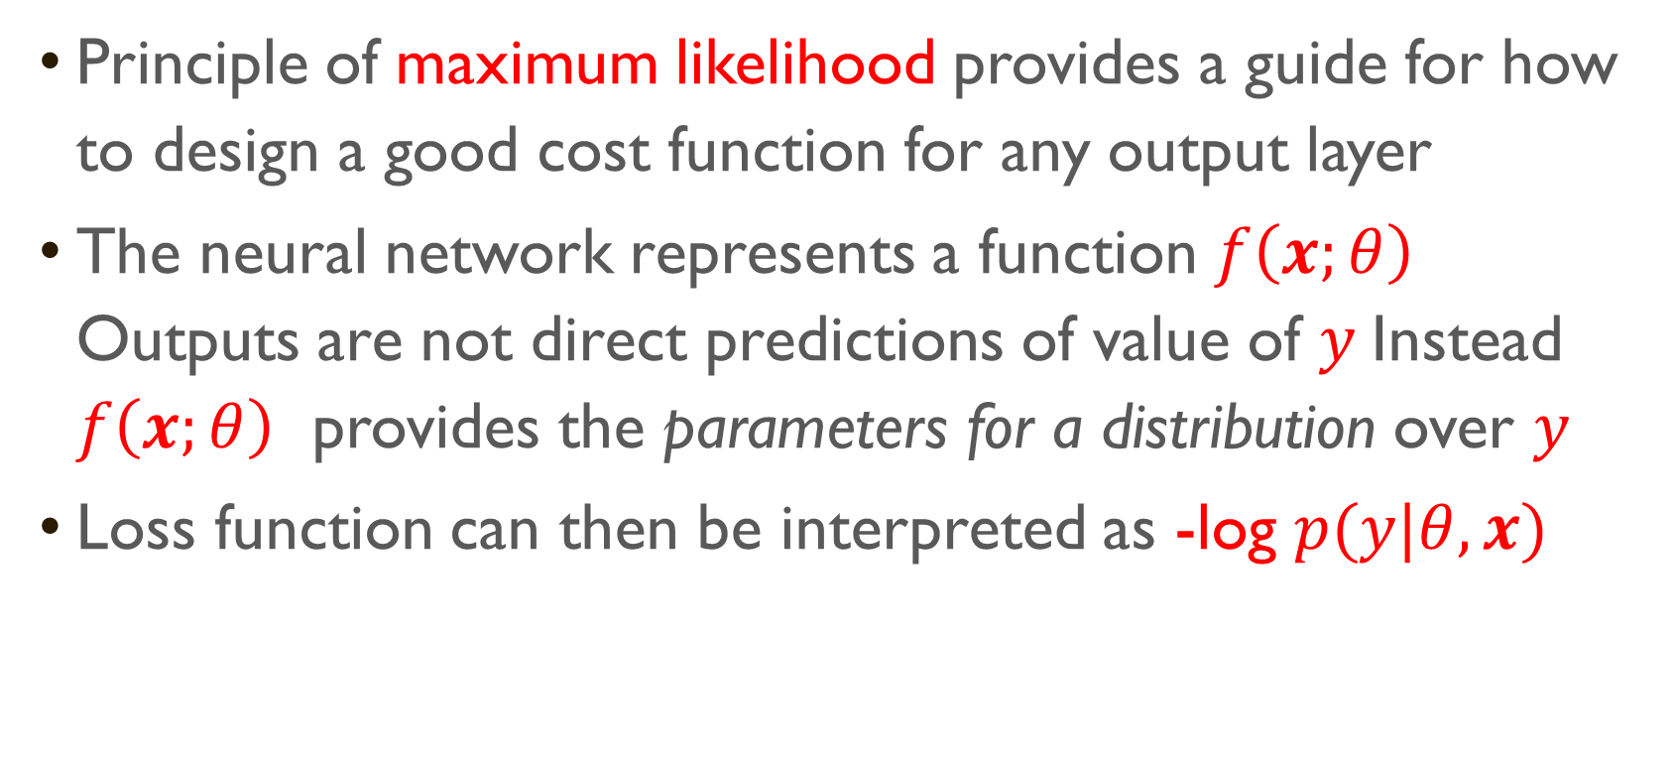
Other Output Types
Principle of maximum likelihood provides a guide for how to design a good cost function for any output layer
The neural network represents a function $f\left(x;θ\right)$ Outputs are not direct predictions of value of $y$Instead $f\left(x;θ\right)$ provides the parameters for a distribution over $y$
Loss function can then be interpreted as -log $p(y|θ,x)$

Slide 21
Summary
Feedforward neural network
Approximate non-linear functions via transformed input φ(x)
Principle of Deep Learning: Learn φ
Output units: linear, sigmoid, softmax, others
Bernoulli: sigmoid vs softplus
Multinoulli: Softmax
Avoid gradient of the cost function to shrink to too small
Cost functions: Likelihood, MSE, MAE
Binary output: cross-entropy
Real value: MSE
Calculus of Variation:
MSE ≅ mean
MAE ≅ median

Slide 22
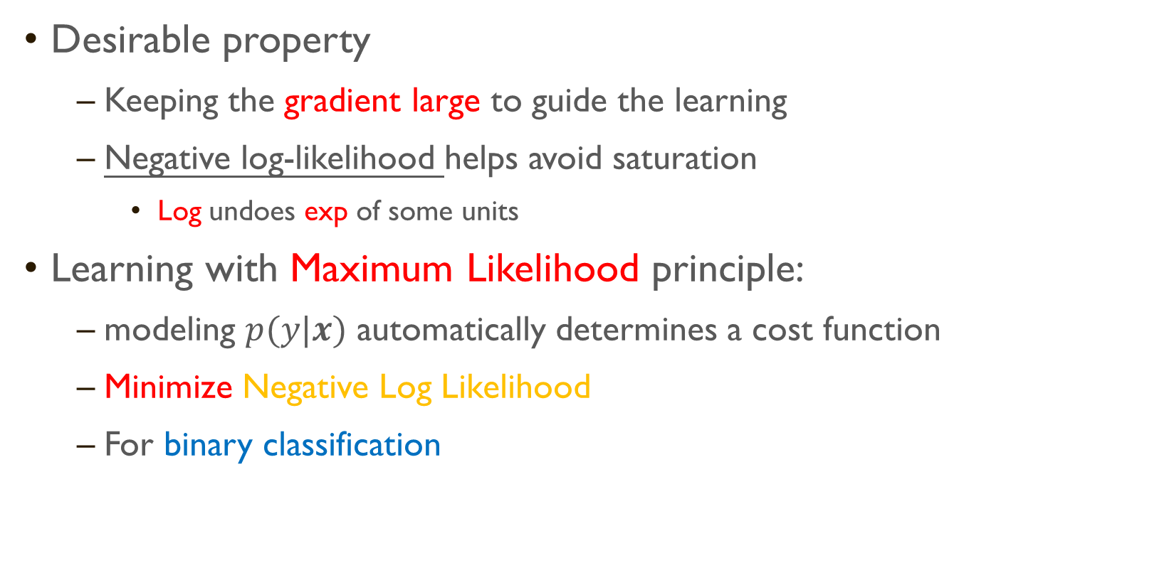
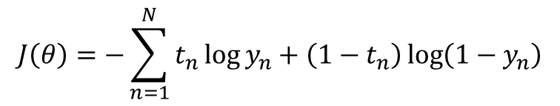
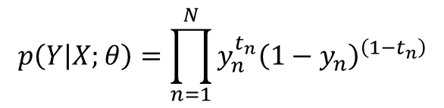
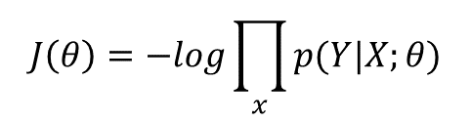
Cost Functions
Desirable property
Keeping the gradient large to guide the learning
Negative log-likelihood helps avoid saturation
Log undoes exp of some units
Learning with Maximum Likelihood principle:
modeling $p(y|x)$ automatically determines a cost function
Minimize Negative Log Likelihood
For binary classification
What about regression problem?
$$J\left(θ\right)=−log\prod_{x}{p(Y|X;θ)}$$
$$p\left(Y | X;θ\right)=\prod_{n=1}^{N}{{y_{n}^{t_{n}}\left(1−y_{n}\right)}^{\left(1−t_{n}\right)}}$$
$$J\left(θ\right)=−\sum_{n=1}^{N}{t_{n}\log{y_{n}}+\left(1−t_{n}\right)\log\left(1−y_{n}\right)}$$

Slide 23
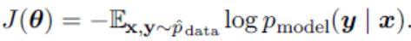
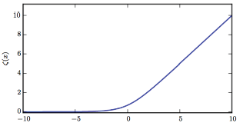
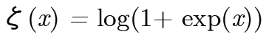
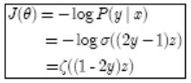

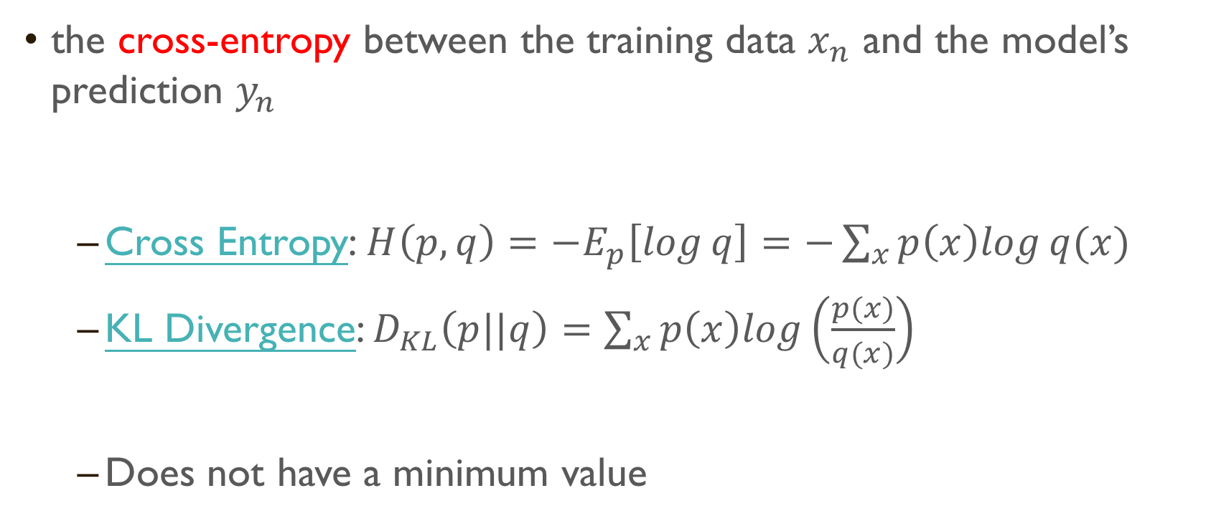
Cost functions: For Binary classification
the cross-entropy between the training data $x_{n}$ and the model’s prediction $y_{n}$
Cross Entropy: $H\left(p,q\right)=−E_{p}\left[\log{q}\right]=−\sum_{x}{p\left(x\right)log⁡q(x)}$
KL Divergence: $D_{KL}\left(p||q\right)=\sum_{x}{p\left(x\right)log\left(\frac{p(x)}{q(x)}\right)}$
Does not have a minimum value
Relation between Cross Entropy and KL Divergence?
$$D_{KL}\left(p||q\right)=−H\left(p\right)+H(p,q)$$
Notes:
$$D_{KL}\left(p||q\right)=−H\left(p\right)+H(p,q)$$
For Softplus
J(θ) saturates only when $\left(1−2y\right)z≪0$

Slide 24
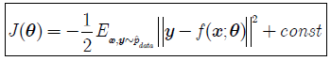
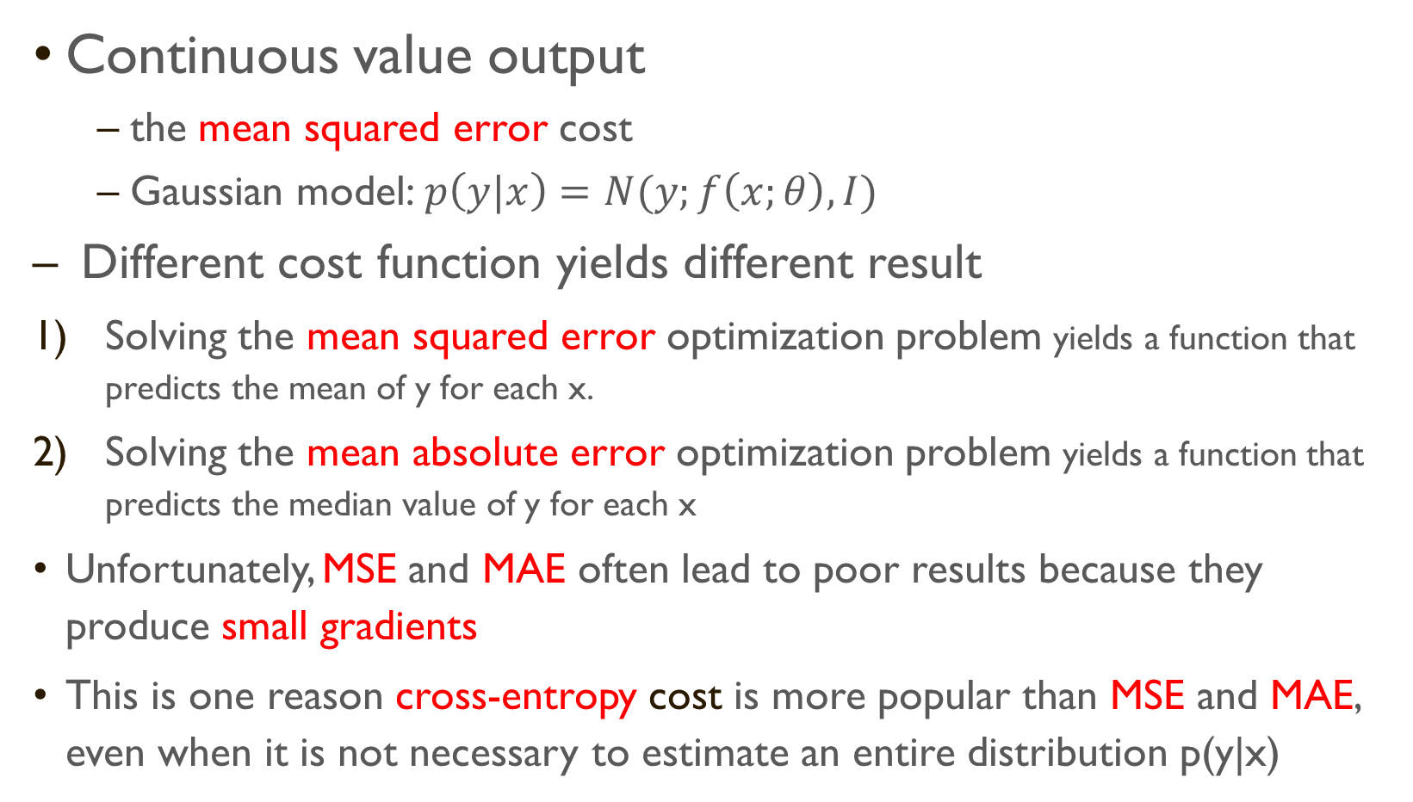
Cost Functions (Cont.)
Continuous value output
the mean squared error cost
Gaussian model:$p\left(y|x\right)=N(y;f\left(x;θ\right),I)$
Different cost function yields different result
Solving the mean squared error optimization problem yields a function that predicts the mean of y for each x.
Solving the mean absolute error optimization problem yields a function that predicts the median value of y for each x
Unfortunately, MSE and MAE often lead to poor results because they produce small gradients
This is one reason cross-entropy cost is more popular than MSE and MAE, even when it is not necessary to estimate an entire distribution p(y|x)

Slide 25
Output vs. Cost Function
Output Type | Output Distribution | Output Layer | Cost Function
Binary | Bernoulli | Sigmoid | Binary Cross Entropy
Discrete | Multinoulli | Softmax | Discrete Cross Entropy
Continuous | Gaussian | Linear | Gaussian Cross Entropy (MSE)
 | Mixture of Gaussian | Mixture Density | Cross Entropy
 | Arbitrary | GAN, VAE, etc. | Various

Slide 26
下列敘述何者錯誤?
ⓘ Start presenting to display the poll results on this slide.

Slide 27

Hidden Layers
Functions of Hidden Layers
Automatic Feature Engineering
Representation of input
Discovering interactions between input variables
Sigmoid, Tanh,
ReLU and its variants
Maxout

Slide 28
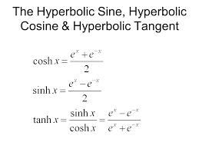
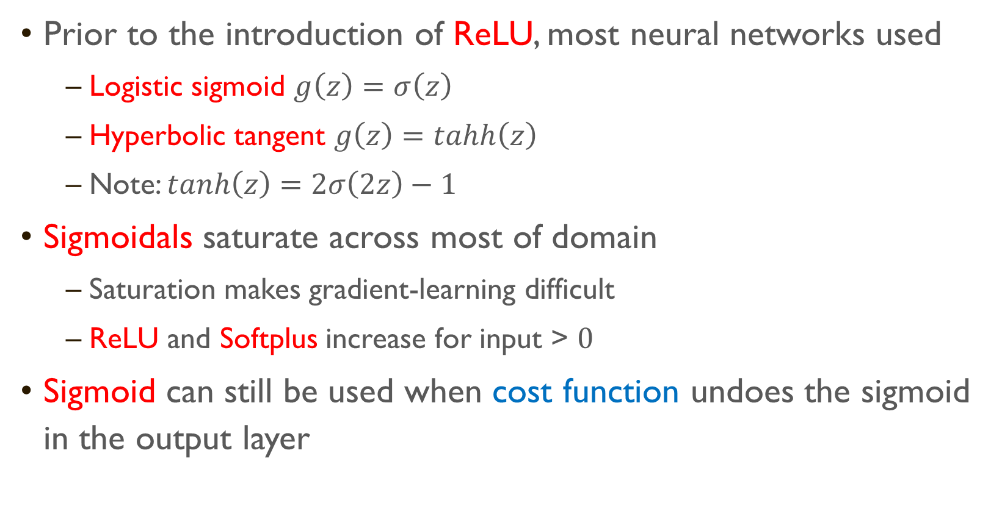
Logistic Sigmoid Hidden Units
Prior to the introduction of ReLU, most neural networks used
Logistic sigmoid $g\left(z\right)=σ\left(z\right)$
Hyperbolic tangent $g\left(z\right)=tahh\left(z\right)$
Note: $tanh\left(z\right)=2σ\left(2z\right)−1$
Sigmoidals saturate across most of domain
Saturation makes gradient-learning difficult
ReLU and Softplus increase for input > $0$
Sigmoid can still be used when cost function undoes the sigmoid in the output layer

Slide 29
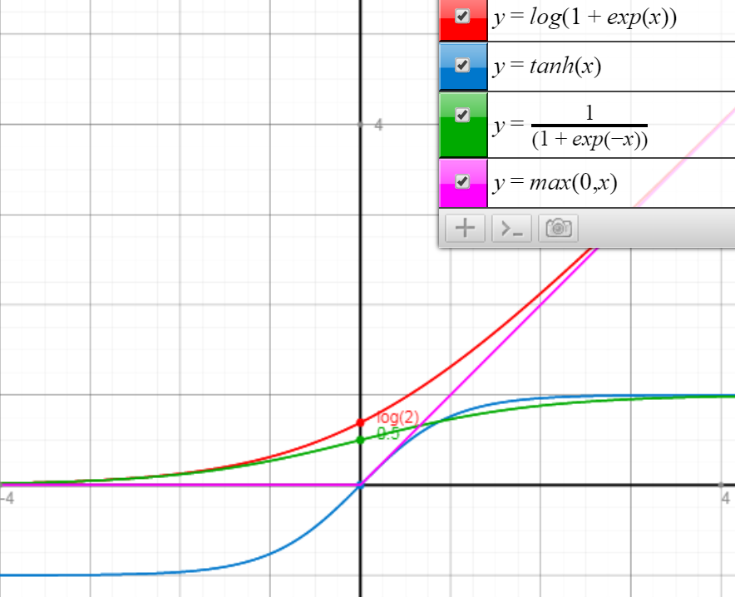
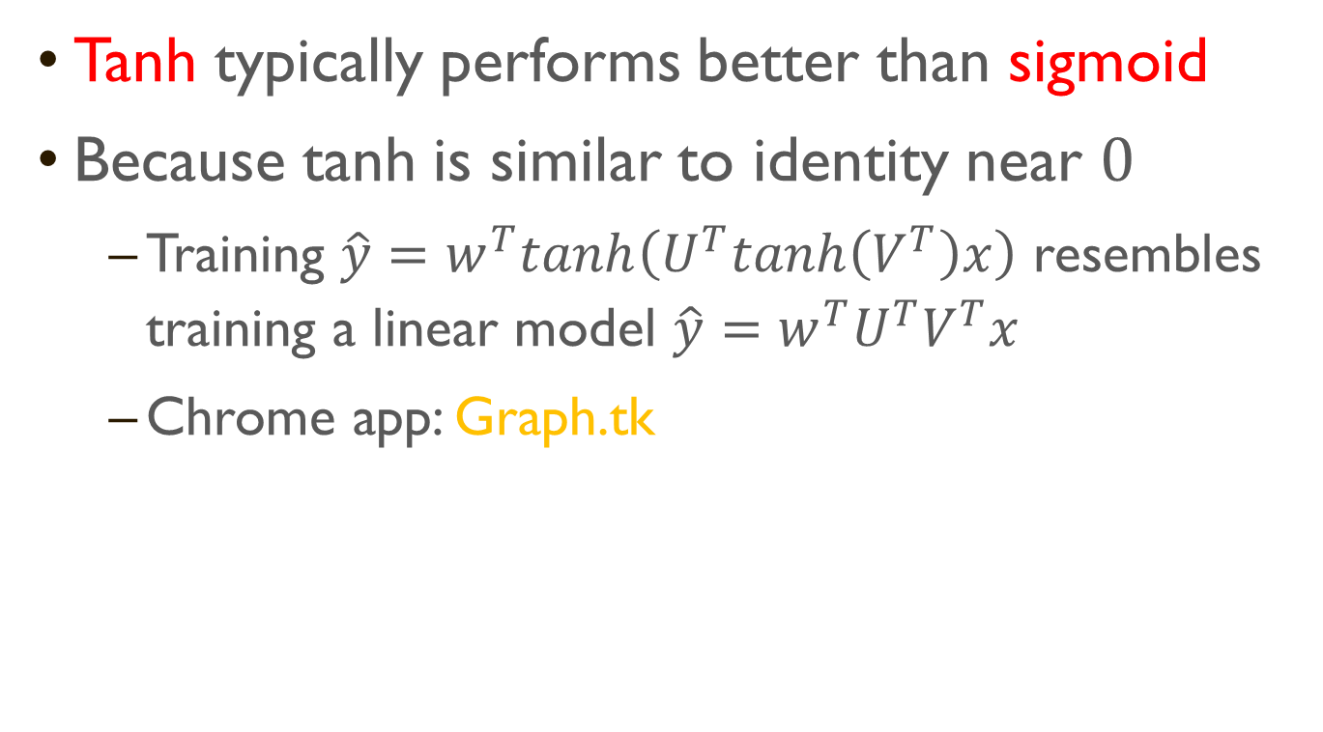
Tanh Activation vs. Sigmoid
Tanh typically performs better than sigmoid
Because tanh is similar to identity near $0$
Training $\hat{y}=w^{T}tanh\left(U^{T}tanh\left(V^{T}\right)x\right)$ resembles training a linear model $\hat{y}=w^{T}U^{T}V^{T}x$
Chrome app: Graph.tk

Slide 30
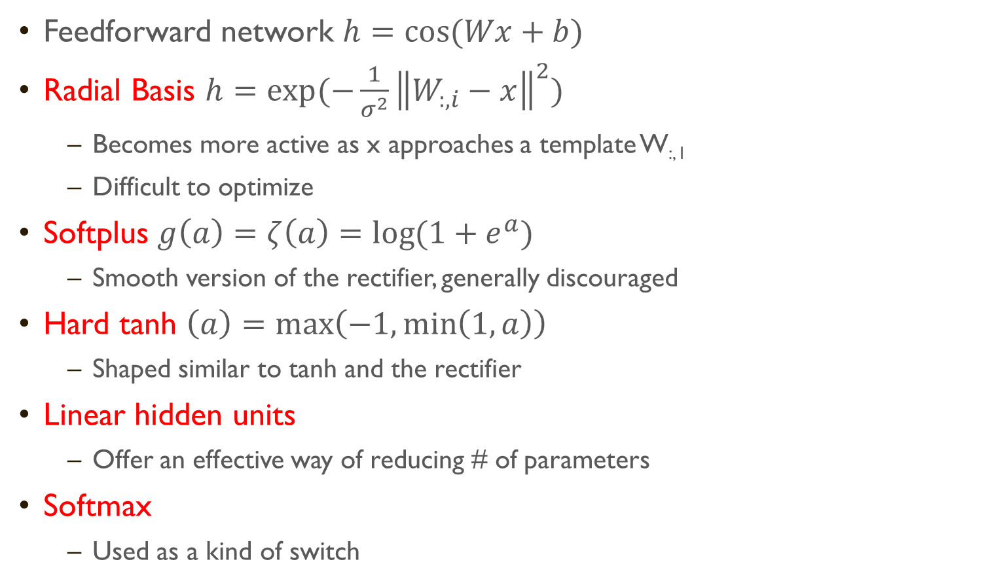
Other Hidden Units
Feedforward network $h=cos⁡(Wx+b)$
Radial Basis $h=exp⁡(−\frac{1}{σ^{2}}{\left\|W_{:, i}−x\right\|}^{2})$
Becomes more active as x approaches a template W_{:, I}
Difficult to optimize
Softplus $g\left(a\right)=ζ\left(a\right)=\log{(1+e^{a})}$
Smooth version of the rectifier, generally discouraged
Hard tanh $\left(a\right)=\max\left(−1,\min\left(1,a\right)\right)$
Shaped similar to tanh and the rectifier
Linear hidden units
Offer an effective way of reducing # of parameters
Softmax
Used as a kind of switch
Notes:
W: p*n,
V:p*q, U:q*n, (p+n)*q

Slide 31
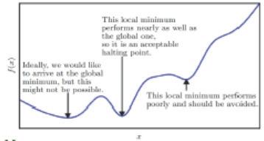
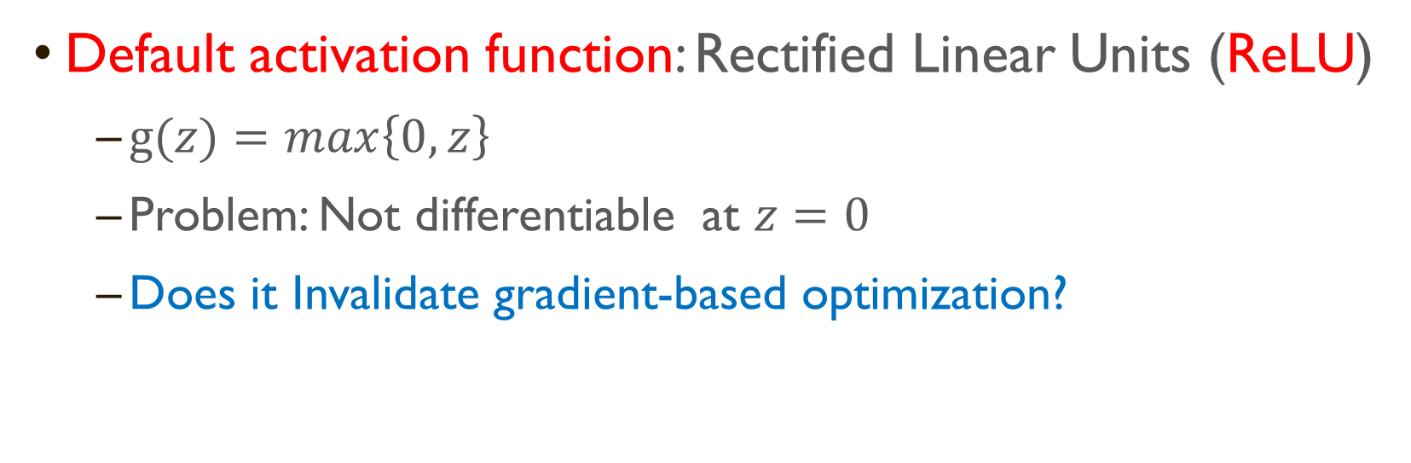
Hidden Units - ReLU
Default activation function: Rectified Linear Units (ReLU)
$g(z)=max\left\{0,z\right\}$
Problem: Not differentiable at $z=0$
Does it Invalidate gradient-based optimization?
Non-differentiable at only a small number of points
Not usually arrives at a local minimum, instead reduces value significantly
Not expecting training to reach a point where gradient is zero

Slide 32
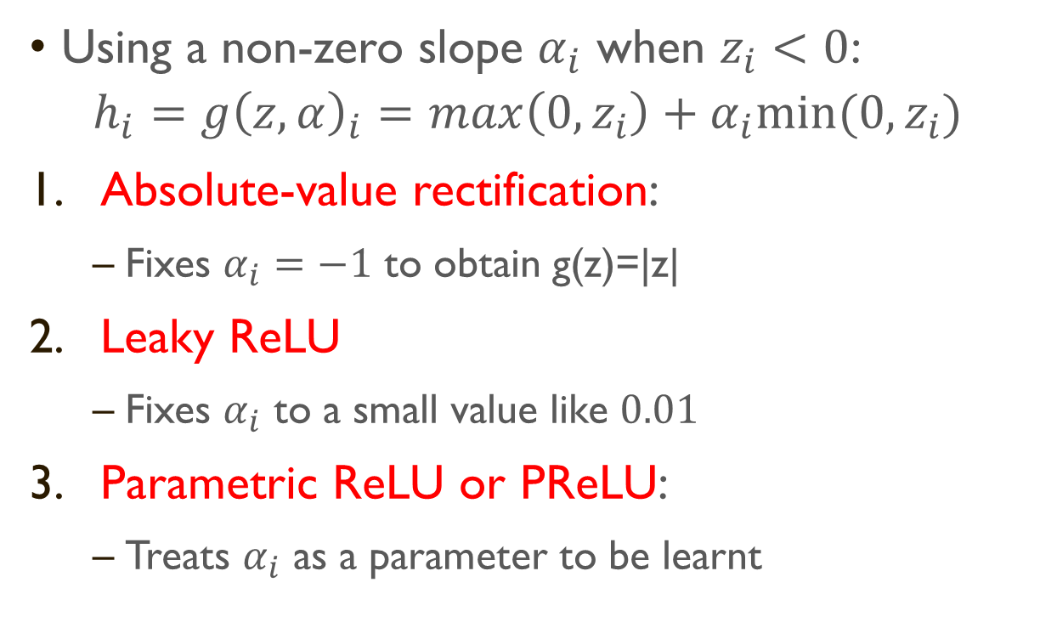
Three Generalizations of ReLU
Using a non-zero slope $α_{i}$ when $z_{i}<0$:
$$h_{i}={g\left(z,α\right)}_{i}=max\left(0,z_{i}\right)+α_{i}min⁡(0,z_{i})$$
Absolute-value rectification:
Fixes $α_{i}=−1$ to obtain g(z)=|z|
Leaky ReLU
Fixes $α_{i}$ to a small value like $0.01$
Parametric ReLU or PReLU:
Treats $α_{i}$ as a parameter to be learnt

Slide 33
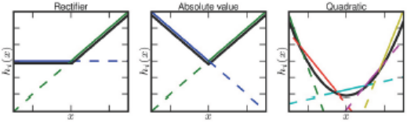
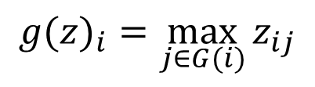
Maxout Units
Learn piecewise linear, convex function with up to k pieces
Divide z into m groups of k values
Learning the activation function itself rather than just the relationship between units
With large enough k, approximate any convex function
A maxout layer with 2 pieces ≅ ReLU or its generalization
$${g(z)}_{i}=\max_{j∈G(i)}{z_{ij}}$$

Slide 34
Learning Activation Functions
Each maxout unit is parametrized by k hidden neurons
Require k*m neurons for m output
Typically need more regularization than rectified linear units
Can work well without regularization if the training set is large and the number of pieces per unit is kept low

Slide 35
Illustration of Maxout Units
Other benefits: Because of multiple filters, maxout units have some redundancy to resist catastrophic forgetting
Notes:
In some cases, one can gain some computational advantages by requiring fewer parameters
If the features can be summarized by taking the max over each group of k features, then the next layer can get by with k times fewer weights

Slide 36
下列敘述何者正確? (多選)
ⓘ Start presenting to display the poll results on this slide.

Slide 37
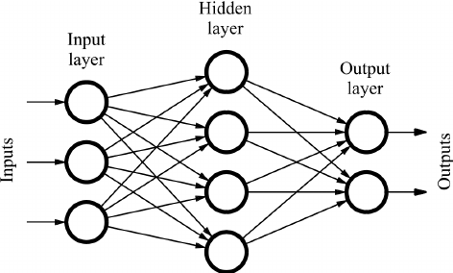
Main Architecture Considerations
Chain-based Architecture
Choice of depth of network
Choice of width of each layer
Ideal network architecture must be found via experimentation guided by validation set error
Notes:
Most neural networks are organized into groups of units called layers
These layers are arranged in a chain structure
With each layer being a function of the layer preceded it
$$h^{(1)}=g^{(1)}\left(W^{\left(1\right)T}x+b^{(1)}\right)$$
$$h^{(2)}=g^{(2)}\left(W^{\left(2\right)T}h^{(1)}+b^{(2)}\right)$$

Slide 38
On the Size of Network
Universal Approximation Theorem
There is a network large enough to achieve any degree of accuracy
but does not say how large the network will be
Some bounds exist for a broad class of function
Worst case is exponential # of hidden units
Using deeper models can reduce # of units and reduce generalization error

Slide 39
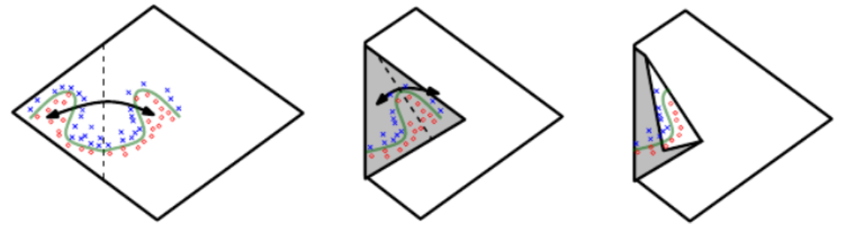
Advantage of Deeper Networks
Manifold Learning
Figure 6.5: An intuitive, geometric explanation of the exponential advantage of deeper rectifier networks
Network with absolute value rectification creates mirror images of the function
Each hidden unit specifies where to fold the input space in order to create mirror responses.
The mirror axis of symmetry is given by the hyperplane defined by the weights and bias of the unit.
Notes:
The mirror axis of symmetry is given by the hyperplane defined by the weights and bias of the unit.

Slide 40
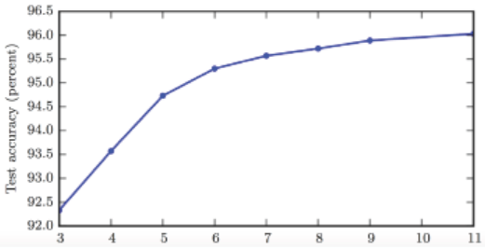
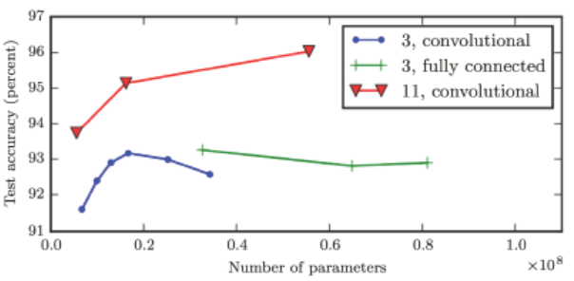
Intuition on Depth
a deep model: the function involve composition of several simpler functions
Deep architectures express a useful prior over the space of functions
Empirically, deeper networks perform better
# of hidden layers

Slide 41
Universal Approximator Theorem
One hidden Layer is enough to represent an approximation of any function to an arbitrary degree of accuracy
So why deeper?
Shallow net may need more width
Shallow net may overfit more

Slide 42
Common Architectural Considerations
Convolutional Networks: Used for computer vision
Recurrent Neural Networks: Used for sequence processing
Non-chain Architecture
Skipping going from layer i to layer i+2 or higher
Making it easier for gradient to flow from output layers to layer nearer input
Specialized networks have fewer connections
Each unit in input layer is connected to only small subset of units in output layer
Reduce no. of parameters and computation
e.g. CNNs use specialized patterns of sparse connections

Slide 43




Ideas Behind CNN
Some patterns are much smaller than the whole image
The same patterns appear in different regions.
Subsampling the pixels will not change the object
subsampling

Slide 44


CNN For Feature Mining
Maximum Pooling
stride of 2
Typical CNN structure
Stacked CNN
Can repeat many times

Slide 45
下列敘述何者正確? (多選)
ⓘ Start presenting to display the poll results on this slide.

Slide 46
6.5 Propagation and Other Differentiation Algorithms
Prerequesite: Matrix calculus
https://explained.ai/matrix-calculus/

Slide 47

Training for Feed-Forward Network
3 Steps:
Forward Propagation
Input x propagates to hidden units at each layer and finally produces an output $\hat{y}$
Backward propagation (backprop)
Allows information from the cost to flow back through network to compute gradient
Stochastic gradient descent
Update weight

Slide 48
Computational Graph Language
A language to describe a function
Useful for back-propagation more precisely
Each node is either
A variable
Scalar, vector, matrix, tensor, etc.
An operation
Simple function of one or more variables
Functions are obtained by composing operations
Draw directed edge from node x to y if y is computed by applying operation to x

Slide 49











Computational Graph Language
J=$l(\hat{y},y)$+λΣw_{i}w_{i}
J
$$u^{(4)}$$
$$u^{(2)}$$
$$u^{(3)}$$
sum
sqr
x
$$y$$
$$\hat{y}$$
$$u^{(1)}$$
y = σ(w^{T}x +b)
H=max{0,XW+b}
$$w$$
$$λ$$

Slide 50
下列關於Backpropagation的敘述何者錯誤? (多選)
ⓘ Start presenting to display the poll results on this slide.

Slide 51







Single-Layer MLP using Cross_Entropy + Regularization
1 1
n×1 n×1 1
n×l₁
l₁×1 l₁×1 1 1
n×l₁
d×l₁ l₁×1 1
n×d
$$y$$
$$W^{(2)}$$
$$λ$$
$$X$$
$$W^{(1)}$$

Slide 52














Feedforward Network
y
W²
W¹
x
b¹
b²
+
+
$$=Softmax\left( \right)$$
$$σ\left( \right)$$
$$z^{1}=W^{1}x+b^{1}$$
$$z^{2}=W^{2}a^{1}+b^{2}$$
$$D$$
$$M$$
$$K$$
x
z¹
a¹
z²
y
$$M$$
$$a^{1}=σ(z^{1})$$
$$K$$
$$y=softmax(z^{2})$$
W¹
W²
$$M×D$$
$$K×M$$
b¹
b²
$$D$$
$$K$$

Slide 53







Loss Function of Feedforward Network
$$C(y,\hat{y})=−\sum_{i=1}{{\hat{y}}_{i}\log{y_{i}}}$$
$$\hat{y}$$
$$C$$
$$z^{1}=W^{1}x+b^{1}$$
$$z^{2}=W^{2}a^{1}+b^{2}$$
x
z¹
a¹
z²
y
$$a^{1}=σ(z^{1})$$
$$y=softmax(z^{2})$$
W¹
W²
b¹
b²

Slide 54











Softmax+Cross-entropy derivative
Softmax and Cross Entropy Loss
https://deepnotes.io/softmax-crossentropy
$$\hat{y}=\left[\begin{aligned}0 \\ 0 \\ ⋮ \\ 1 \\ ⋮\end{aligned}\right]$$
$$y=\left[\begin{aligned}0.1 \\ 0.2 \\ ⋮ \\ 0.6 \\ ⋮\end{aligned}\right]$$
$$C(y,\hat{y})=−\sum_{i=1}{{\hat{y}}_{i}\log{y_{i}}}$$
$$r$$
$$C(y,\hat{y})=−\log{y_{r}}$$
Assume Softmax activation function
$$C(y,\hat{y})==−log\frac{e^{z_{r}}}{\sum_{j}{e^{z_{j}}}}=−z_{r}+log\sum_{j}{e^{z_{j}}}$$
$$Manual computation$$
$$∇_{z_{i}}C=∇_{z_{i}}\left(log\sum_{j}{e^{z_{j}}}−z_{r}\right)$$
$$=\frac{1}{\sum_{j}{e^{z_{j}}}}∇_{z_{i}}\left(\sum_{j}{e^{z_{j}}}\right)−∇_{z_{i}}\left(z_{r}\right)$$
$$∇_{z}C=\left[\begin{aligned}y_{1} \\ y_{2} \\ ⋮ \\ y_{r}−1 \\ ⋮\end{aligned}\right]$$
$$=\frac{e^{z_{i}}}{\sum_{j}{e^{z_{j}}}}−∇_{z_{i}}\left(z_{r}\right)=y_{i}−∇_{z_{i}}\left(z_{r}\right)$$

Slide 55










Gradient of Cost Function
$$C(y,\hat{y})=−\sum_{i=1}{{\hat{y}}_{i}\log{y_{i}}}$$
To compute the gradient automatically…
$$\hat{y}$$
$$C$$
Computing the partial derivative of node v w.r.t. u for each edge (u,v)
Using reverse mode
Output is always a scalar
$${∂C}/{∂y}$$
x
z⁽¹⁾
a⁽¹⁾
z⁽²⁾
y
$$\frac{∂y}{∂z^{(2)}}$$
$$\frac{∂C}{∂W^{(1)}}$$
$$\frac{∂C}{∂W^{(2)}}$$
W⁽¹⁾
W⁽²⁾
vector
$$\frac{∂y}{∂z^{(2)}}=?$$
$$\frac{∂C}{∂b^{(2)}}$$
$$\frac{∂C}{∂b^{(1)}}$$
b⁽¹⁾
b⁽²⁾
vector

Slide 56






Need Matrix Calculus - Jacobian Matrix
https://explained.ai/matrix-calculus/
$$J_{ij}=\frac{∂f_{i}}{∂x_{j}}$$
$f\left(x\right)$: $R^{M}→R^{K}$
$$\frac{∂f}{∂x}=\left[\begin{matrix}{∂y_{1}}/{∂x_{1}} & {∂y_{1}}/{∂x_{2}} & {∂y_{1}}/{∂x_{3}} \\ {∂y_{2}}/{∂x_{1}} & {∂y_{2}}/{∂x_{2}} & {∂y_{2}}/{∂x_{3}}\end{matrix}\right]$$
K
M
Example
$$∇_{x}f=J^{T}$$
$$f\left(\left[\begin{aligned}x_{1} \\ x_{2} \\ x_{3}\end{aligned}\right]\right)=\left[\begin{aligned}x_{1}+x_{2}x_{3} \\ 2x_{3}\end{aligned}\right]$$
$$\frac{∂f}{∂x}=\left[\begin{matrix}1 & x_{3} & x_{2} \\ 0 & 0 & 2\end{matrix}\right]$$

Slide 57












Gradient of Cost Function - I
$$C(y,\hat{y})=−\sum_{i=1}{{\hat{y}}_{i}\log{y_{i}}}$$
$$\hat{y}$$
$$C$$
$$\hat{y}=\left[\begin{aligned}0 \\ 0 \\ ⋮ \\ 1 \\ ⋮\end{aligned}\right]$$
Last Layer
$${∂C}/{∂y}$$
…
…
$$r$$
y
$$\frac{∂C}{∂y_{i}}=?$$
…
…
Cross Entropy:
$$C=−logy_{r}$$
$i=r$:
$${∂C}/{∂y_{r}}=−1/y_{r}$$
$$\frac{∂C}{∂y}=$$
$$\left[\begin{matrix}\begin{matrix}0 & ⋯\end{matrix} & \begin{matrix}−1/y_{r} & ⋯\end{matrix}\end{matrix}\right]$$
$i≠r$:
$${∂C}/{∂y_{i}}=0$$
Notes:
Only one dimension is 1, and others are all 0
Index of the dimension which is 1
Do we have to consider other dimensions?

Slide 58
















Gradient of Cost Function - II
Softmax:
$$y_{i}=\frac{e^{z_{i}}}{\sum_{k}{e^{z_{k}}}}$$
$$C(y,\hat{y})=−\sum_{i=1}{{\hat{y}}_{i}\log{y_{i}}}$$
$$\hat{y}$$
$$C$$
square
$$\frac{∂y}{∂z^{(2)}}$$
$$K$$
is a Jacobian matrix
$${∂C}/{∂y}$$
$$K$$
i-th row, j-th column: ${∂y_{i}}/{∂z_{j}^{(2)}}$
$$\frac{∂y}{∂z^{(2)}}$$
z⁽²⁾
y
$i≠j$:
${∂y_{i}}/{∂z_{j}^{(2)}}$ =
$${−y}_{i}y_{j}$$
$$softmax$$
$i=j$:
${∂y_{i}}/{∂z_{j}^{(2)}}$ =
$$y_{i}\left(1−y_{i}\right)$$
$$y_{1}\left(1−y_{1}\right)$$ | $${−y}_{1}y_{2}$$ | $${−y}_{1}y_{r}$$ | $${−y}_{1}y_{l}$$
$${−y}_{2}y_{1}$$ | $$…$$ | $${−y}_{2}y_{r}$$ | $${−y}_{2}y_{l}$$
$${−y}_{r}y_{1}$$ | $${−y}_{3}y_{2}$$ | $$y_{r}\left(1−y_{r}\right)$$ | $${−y}_{3}y_{l}$$
… |  | …
$\frac{∂y}{∂z^{(2)}}$=
|y|
Softmax and Cross Entropy Loss
https://deepnotes.io/softmax-crossentropy
|z⁽²⁾|
$$r$$

Slide 59































Applying chain rule
$$C(y,\hat{y})=−\sum_{i=1}{{\hat{y}}_{i}\log{y_{i}}}$$
Chain Rule:
$$\frac{∂C}{∂z^{(2)}}$$
$$\frac{∂C}{∂y}$$
$$\frac{∂y}{∂z^{(2)}}$$
$$=$$
$$\hat{y}$$
$$C$$
$$1×K$$
$$1×K$$
$$K×K$$
$$∇_{z^{(2)}}C$$
$$=$$
$${\left(\frac{∂y}{∂z^{(2)}}\right)}^{T}$$
$$∇_{y}C$$
$$1$$
$${∂C}/{∂y}$$
$$K×1←$$
$${(K×K) }^{T}$$
$$K×1$$
$$K$$
$$\frac{∂y}{∂z^{(2)}}$$
$$K$$
$$\frac{∂C}{∂y}=\left[\begin{matrix}0 & ⋯ & \begin{matrix}−1/{y_{r}} & \begin{matrix}⋯ & 0\end{matrix}\end{matrix}\end{matrix}\right]$$
z⁽²⁾
y
$$softmax$$
$$∇_{z}C=\left[\begin{aligned}y_{1} \\ y_{2} \\ ⋮ \\ y_{r}−1 \\ ⋮\end{aligned}\right]$$
$$y_{1}\left(1−y_{1}\right)$$ | $${−y}_{1}y_{2}$$ | $${−y}_{1}y_{r}$$ | $${−y}_{1}y_{K}$$
$${−y}_{2}y_{1}$$ | $$…$$ | $${−y}_{2}y_{r}$$ | $${−y}_{2}y_{K}$$
$${−y}_{r}y_{1}$$ | $${−y}_{r}y_{2}$$ | $$y_{r}\left(1−y_{r}\right)$$ | $${−y}_{r}y_{K}$$
… |  | …
$$\left[\begin{aligned}0 \\ 0 \\ ⋮ \\ −1/{y_{r}} \\ ⋮\end{aligned}\right]$$
$$=$$
$$×$$
$$Same result as slide 44$$
$$r$$

Slide 60




Softmax+Cross entropy loss
Softmax and Cross Entropy Loss
https://deepnotes.io/softmax-crossentropy
Cross-entropy
Softmax
$$y=\left[\begin{matrix}0 \\ 1 \\ 0\end{matrix}\right]$$
z
y
Loss
1-hot encoding
$$p=\left[\begin{matrix}0 \\ 1 \\ 0\end{matrix}\right]$$
$$q=\left[\begin{matrix}0.23 \\ 0.63 \\ 0.14\end{matrix}\right]$$
$$=−logq_{r}$$

Slide 61
















$$z^{(2)}=W^{(2)}a^{(1)}$$
$$C(y,\hat{y})=−\sum_{i=1}{{\hat{y}}_{i}\log{y_{i}}}$$
$$z_{i}^{(2)}=\sum_{m=1}^{M}{w_{im}^{(2)}a_{m}^{(1)}}$$
$$\hat{y}$$
$$C$$
$$\frac{∂z_{i}^{(2)}}{∂W}=\left[\begin{matrix}0 & ⋯ & 0 \\ a_{1}^{(1)} & a_{j}^{(1)} & a_{1}^{(1)} \\ 0 & ⋯ & 0\end{matrix}\right]$$
$${∂C}/{∂y}$$
$$i$$
K
$$\frac{∂y}{∂z^{(2)}}$$
KxM
a⁽¹⁾
$$W^{(2)}$$
Z⁽²⁾
y
$$\frac{∂z_{i}^{(2)}}{∂W_{jm}^{(2)}}=0$$
M
$$softmax$$
$i≠j$:
$$\frac{∂z^{(2)}}{∂W^{(2)}}=$$
W⁽²⁾
$$\frac{∂z_{i}^{(2)}}{∂W_{im}^{(2)}}=a_{m}^{(1)}$$
KxM
K
$i=j$:
KxM
(considering ${∂z^{2}}/{∂W^{2}}$ as a tensor makes thing easier)

Slide 62





























Chain Rule of Calculus
$$M×K$$
$$K$$
$$K$$
$$1$$
$$W^{(1)}→z^{(2)}→y→C$$
$$\frac{∂z^{(2)}}{∂W^{(1)}}$$
$$\frac{∂y}{∂z^{(2)}}$$
$$\frac{∂C}{∂y}$$
$$\frac{∂C}{∂y}$$
$$\frac{∂y}{∂z^{(2)}}$$
$$\frac{∂z^{(2)}}{∂W^{(1)}}$$
$$[\begin{matrix}⋯ & ⋯ & ⋯ \\ ⋮ & \frac{∂C}{∂W_{ij}^{(1)}} & ⋮ \\ ⋯ & ⋯ & ⋯\end{matrix}]$$
$$\frac{∂C}{∂W^{(1)}}$$
$$=$$
$$=$$
$$1×(M×K)$$
1$×K$
$$K×K$$
$$K×(M×K)$$
$$M×K$$
$$\frac{∂C}{∂W^{(1)}}$$
$$\frac{∂C}{∂z}$$
$$\frac{∂z^{(2)}}{∂W^{(1)}}$$
$$=$$
$$=$$
$$\left[\begin{matrix}y_{1} & ⋯ & \begin{matrix}y_{r}−1 & \begin{matrix}⋯ & y_{K}\end{matrix}\end{matrix}\end{matrix}\right]$$
K
$$1×(M×K)$$
1$×K$
$$K×(M×K)$$
KxM
62

Slide 63



Questions
Using sigmoid instead of softmax
Q: Only backward pass for computational graph?
$$δ^{L}=\frac{∂C}{∂z^{(2)}}$$
Q: Do we get the same results from the two different approaches?
https://en.wikipedia.org/wiki/Backpropagation

Slide 64
Two Approaches to Backpropagation
Symbol-to-Number Differentiation
Take a computational graph and a set of numerical values for inputs to the graph
Return a set of numerical values describing gradient at those input values
Used by Torch and Caffe
Symbol-to-Symbol Differentiation
Take a computational graph
Add additional nodes to the graph that provide a symbolic description of desired derivatives
Used by Theano and Tensorflow

Slide 65


Symbol-to-Symbol Derivatives
z= f ( f ( f (w)))
y= f ( f (w))
x= f (w)
$\frac{dz}{dy}=f^{′}\left(y\right)$
$\frac{dy}{dx}=f′(x)$
$\frac{dz}{dx}=\frac{dz}{dy}\frac{dy}{dx}=f′(y)f′(x)$
$\frac{dx}{dw}=f′(w)$
$\frac{dz}{dw}=\frac{dz}{dx}\frac{dx}{dw}=f′(x)f′(w)$

Slide 66


General Backpropagation
To compute gradient of scalar z wrt one of its ancestors x in the graph
$$∇_{x}z={\left(\frac{∂y}{∂x}\right)}^{T}∇_{y}z$$
Begin by observing that gradient wrt z is $\frac{dz}{dz}=1$
Then compute gradient wrt each parent of z by multiplying current gradient by Jacobian of the operation that produced z
We continue multiplying by Jacobians traveling backwards until we reach x
For any node that can be reached by going backwards from z through two or more paths sum the gradients from different paths at that node

Slide 67
Software Implementations
Usually provide both:
Operations
Their bprop methods
Users of software libraries are able to backpropagate through graphs built using common operations like
Matrix multiplication, exponents, logarithms, etc
To add a new operation to existing library must derive ob.prop method manually

Slide 68

Generic Neural Network Example

Slide 69
Summary & Next Step
Multilayer perceptron (MLPs)
FC NN, neuron, activation function, cost function
Computational Graph
Specialized NN
Convolutional NN
Recurrent Neural Network
Gated Mechanism, Long short term memory, Gated recurrent Unit
Attention, Transformer
Deep Learning for NLP
Deep Learning for Image Processing

Slide 70
Concluding Remarks
1. What is the model (function hypothesis set)?
2. What is the “best” function?
3. How to pick the “best” function?
Neural Network
Cost Function
Gradient Descent
Parameter Initialization
Learning Rate
Stochastic gradient descent, Mini-batch
Recipe for Learning

Slide 71

Audience Q&A Session
ⓘ Start presenting to display the audience questions on this slide.

